Slide 1
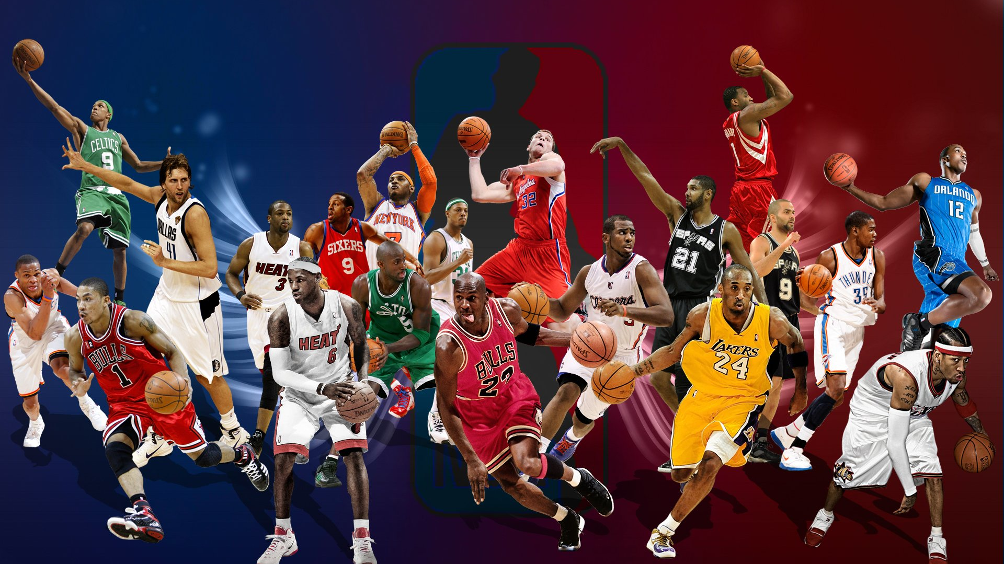


Building the Dream Team 2022
SC1015
Group 1
Advait Bharat Deshpande
U2122619C
Anand Chaanan Singh
U2121793B
Bryan Lim Kai Wen
U2121763H

Slide 2





The Problem: Managers today struggle to consistently build winning teams as players grow more versatile
Dataset
Player statistics from NBA.com
What is the situation?
It is increasingly difficult to predict Team Success based on traditional indicators such as height or strength
Players like Lebron James have turned the game on its head in the modern era by playing roles that defy what is traditionally expected of a player of his size
Why?
Players have greater access to training facilities and are able to widen their skillsets beyond their preferred positions
This will result in managers having to deal with more variation among players with added complexity to team strategy

Slide 3
The Problem: Managers today struggle to consistently build winning teams as players grow more versatile
Dataset
Player statistics from NBA.com
What is the situation?
It is increasingly difficult to predict Team Success based on traditional indicators such as height or strength
Hence, how might we provide more insightful recommendations on team composition to today's managers to deal with this complexity?
Players like Lebron James have turned the game on its head in the modern era by playing roles that defy what is traditionally expected of a player of his size
Why?
Players have greater access to training facilities and are able to widen their skillsets beyond their preferred positions
This will result in managers having to deal with more variation among players with added complexity to team strategy

Slide 4
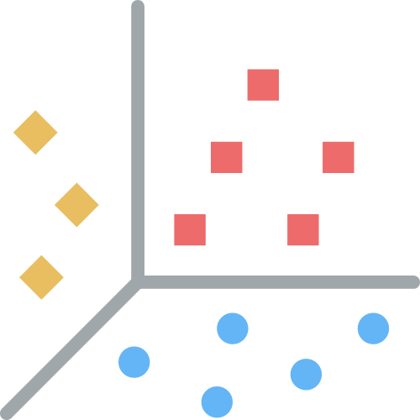




The Data Set: To answer this question, we aim to analyse publicly available player statistics from NBA.com
Data Problem
Given various player attributes and play statistics, how can we group similar players together?
VS
Our Hypothesis: We will be able to uncover underlying patterns among players using the scraped data through data exploration and machine learning techniques
Extending the problem
We then analyze the compositions of all teams to determine what makes top performing NBA teams

Slide 5







Tech Stack: These are the main libraries and tools we deployed to conduct our analysis
Data Collection
Data Cleaning
Data Analysis

Slide 6
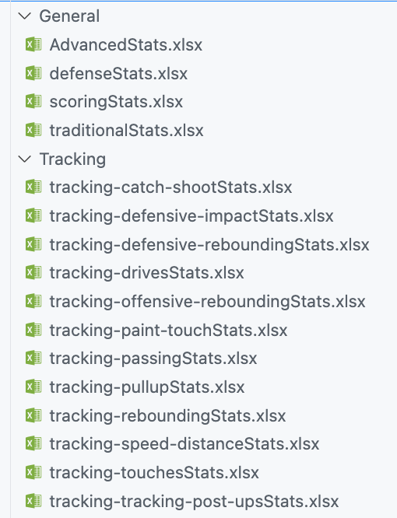

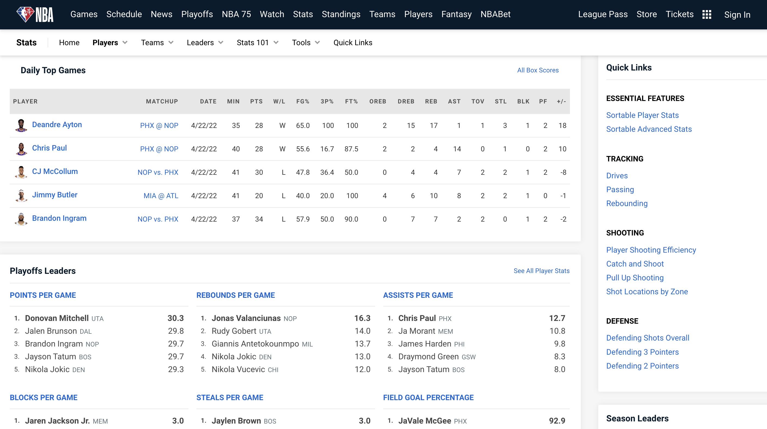
Data Collection: Using Selenium Webdriver and BeautifulSoup4 to scrape the preliminary data to form our main Data Set
Initial Data
We picked general and specific data that was most descriptive of a players’ style
Collected up to 292 Columns of statistics to paint a comprehensive picture of the player
Notes:
Now, in order to set the stage right, these are the main tools we used to conduct our analysis. Using selenium and beautifulsoup4, we scraped both general and specific data that was indicative of a players’ style, and were able to collect up to 292 columns of statistics to paint a comprehensive picture of the player

Slide 7

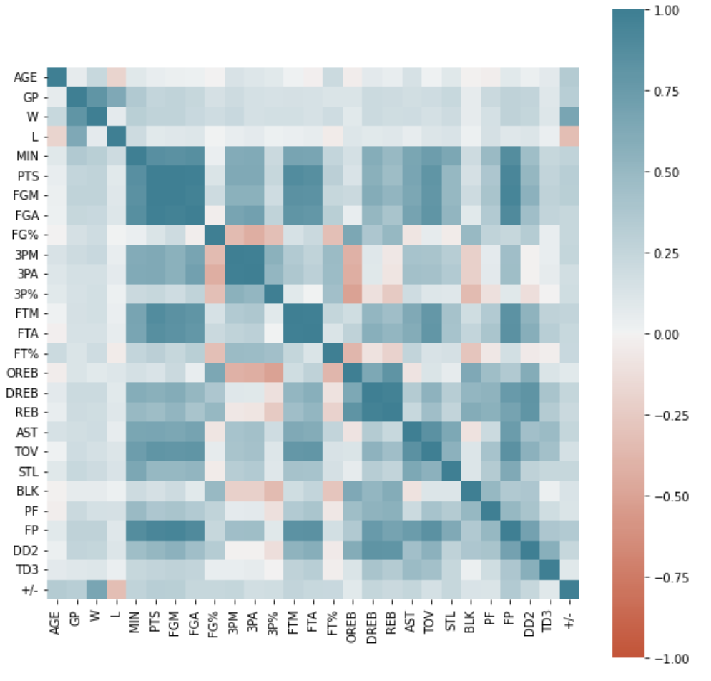
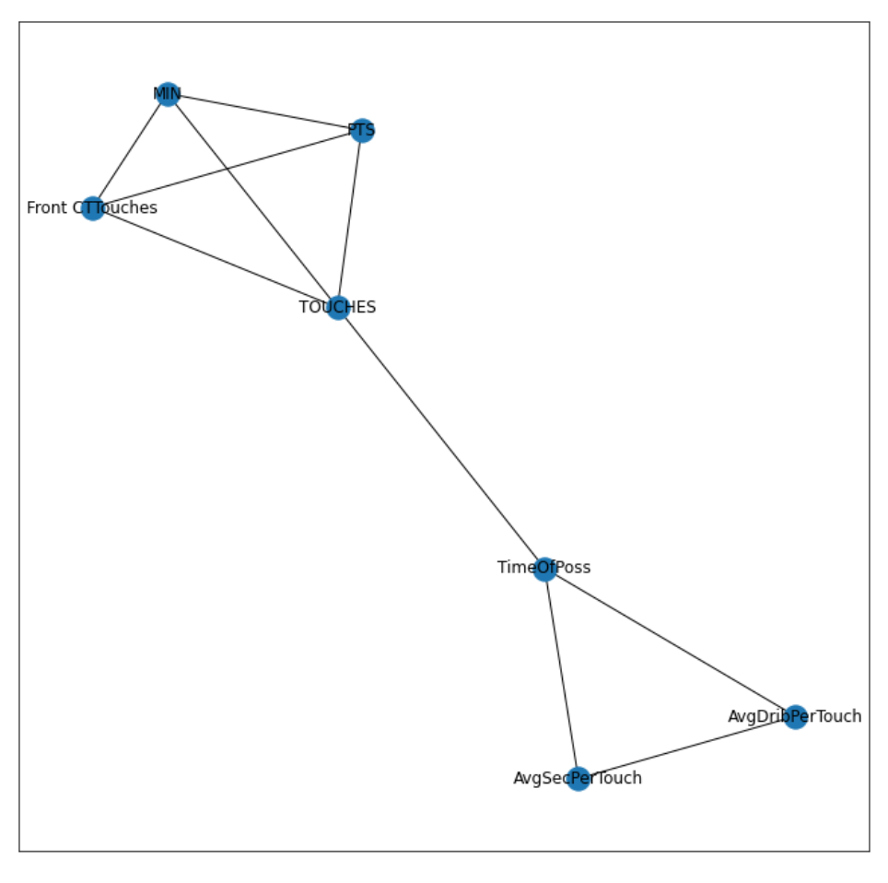
Cleaning and Curation: Upon initial exploration, there was a need to further clean and select for relevant features to build our Data Set
Too many variables can negatively impact a model if they are irrelevant or partially relevant
Hence, we engaged in Dimension Reduction
Heat Maps
Correlation Graphs
In order to eliminate irrelevant/partially relevant data, we considered the Correlation between various data points.
Notes:
Now, in order to set the stage right, these are the main tools we used to conduct our analysis. Using selenium and beautifulsoup4, we scraped both general and specific data that was indicative of a players’ style, and were able to collect up to 292 columns of statistics to paint a comprehensive picture of the player. However, upon initial exploration, we found the need to further clean and select for relevant features, as having too many variables can hinder the model if they are irrelevant. Hence, we engaged in dimension reduction with the aid of heat maps and correlation graphs to drop the least relevant data points.

Slide 8
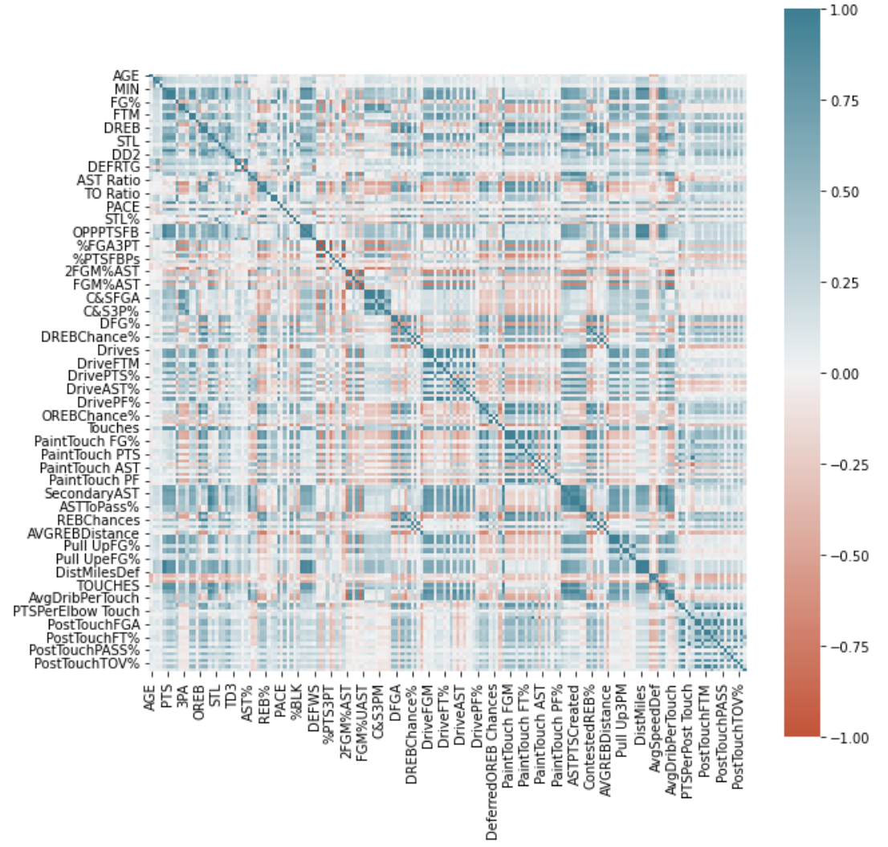
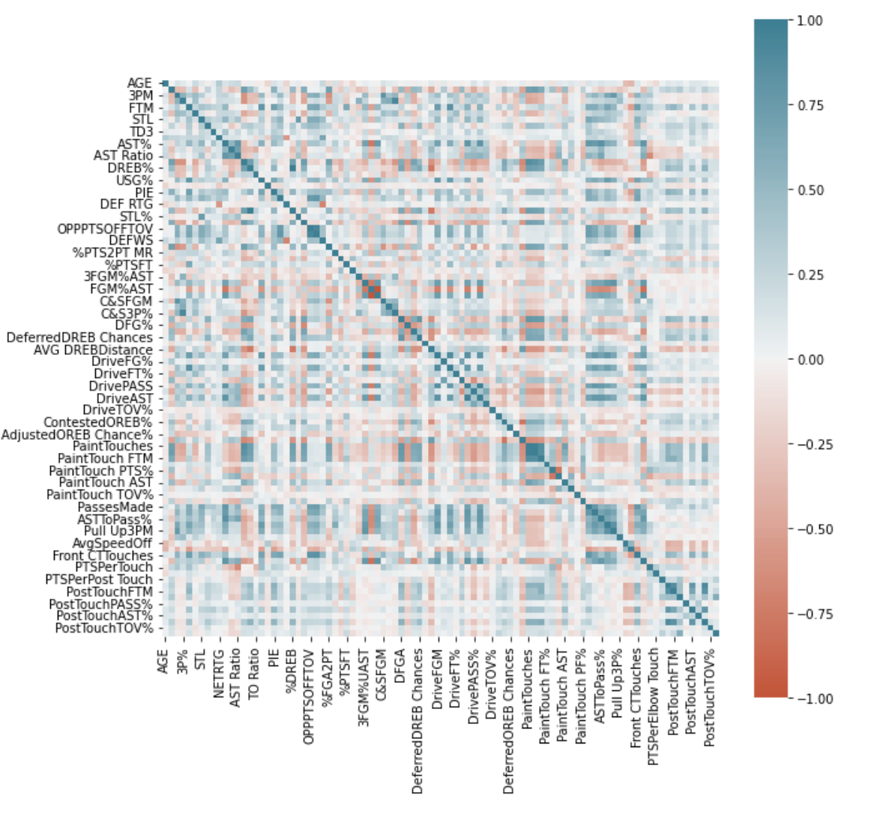
Cleaning and Curation: However, there were still a significant number of columns in the Data Set which could negatively impact the analysis
Before
After

Slide 9
Cleaning and Curation: However, there were still a significant number of columns in the Data Set which could negatively impact the analysis
Before
After
Thus, we need an alternative method to reduce the dimensionality of the data

Slide 10
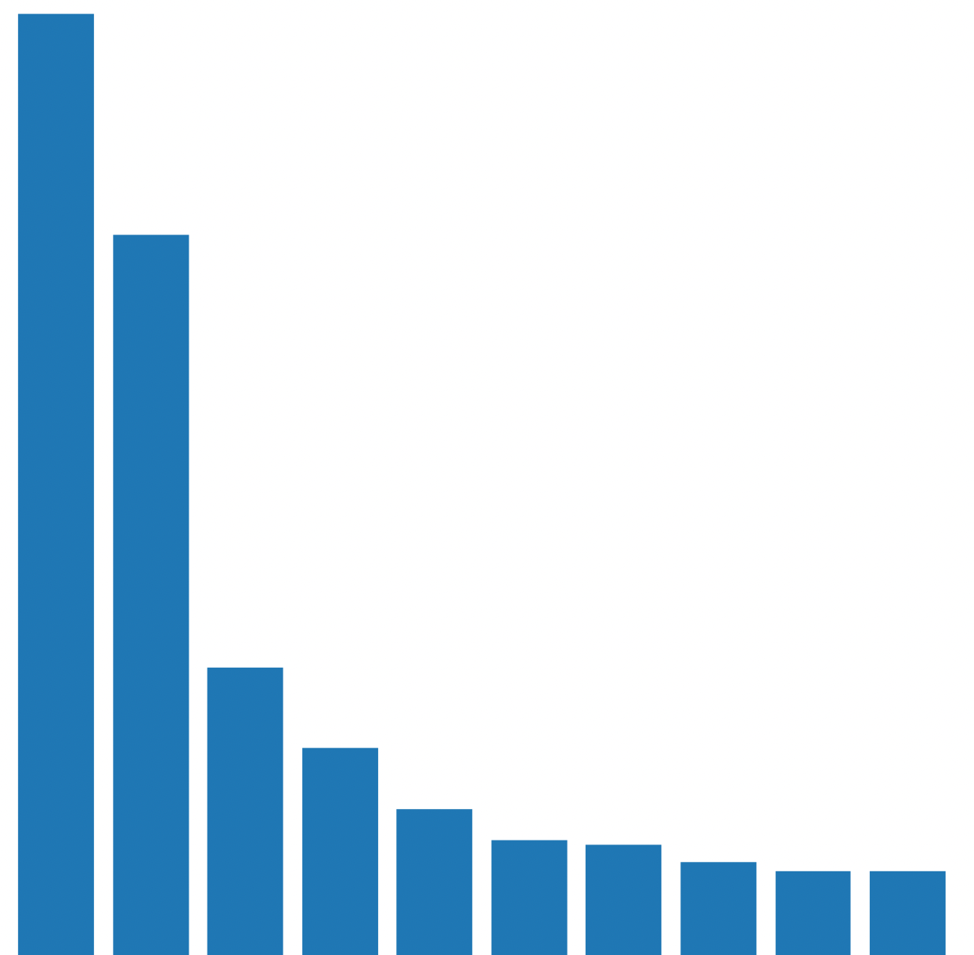

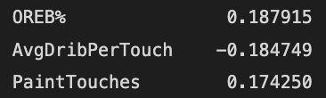
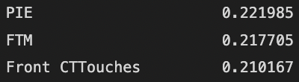
Cleaning and Curation: To further reduce the dimensionality of the data, we conducted a Principal Component Analysis to boil down the data further
21%
There is still a balancing act
Explained Variance
Interpretability
&
High
16%
53 %
% of variance explained
Most significant loading scores
7%
5%
PC1
PC2
3%
PC1
PC2
PC3
PC4
PC5
PC6
PC7
PC8
PC9
PC10
Principal Component

Slide 11





Cleaning and Curation: To further reduce the dimensionality of the data, we conducted a Principal Component Analysis to boil down the data further
Interpreting the 5 Principal Components
PC1:
Predominately plays close to the basket. It’s safe to assume Centers would have high PC1 values.
PC2:
Offensive minded players that can score in all manner
PC3:
Assist makers that cannot shoot the ball well and steal the ball
PC4:
Have positive net rating on the team and pass the ball more than they shoot. They also stay in the paint. Seems to be forwards/centers that can pass the ball well.
PC5:
Interesting PC as it does not follow conventional trends from the players with the high values. There is a mix of guards, forwards and centers in this PC.

Slide 12
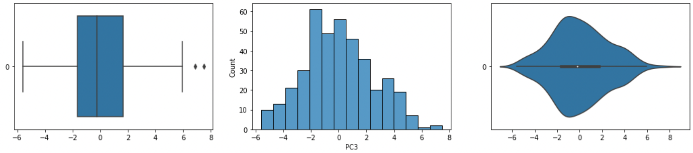


Further exploration: Having obtained our Principal Components we were able to generate preliminary insights regarding our problem
Analysis Tool
Insight
Reasonable Hopkins Statistic
Indicates natural clustering tendencies
~0.3
Violin plots and anomaly counts
Some skewness but not many outliers
Comparing high positive and high negative players for each principal component
Qualitative comparison shows that such players are unlikely to belong to the same group
High PC1
Low PC1

Slide 13
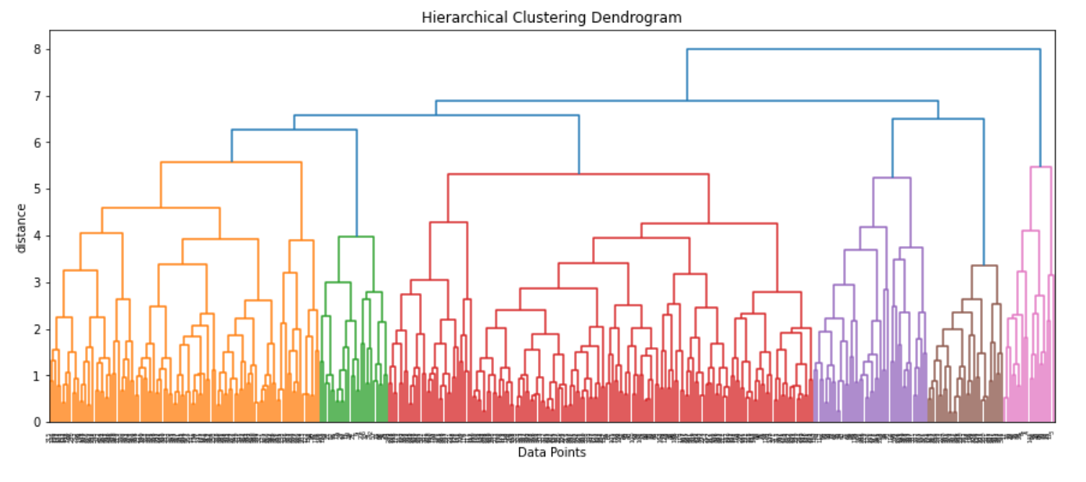
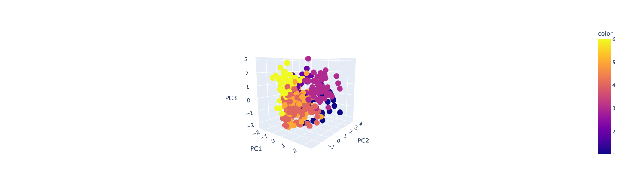
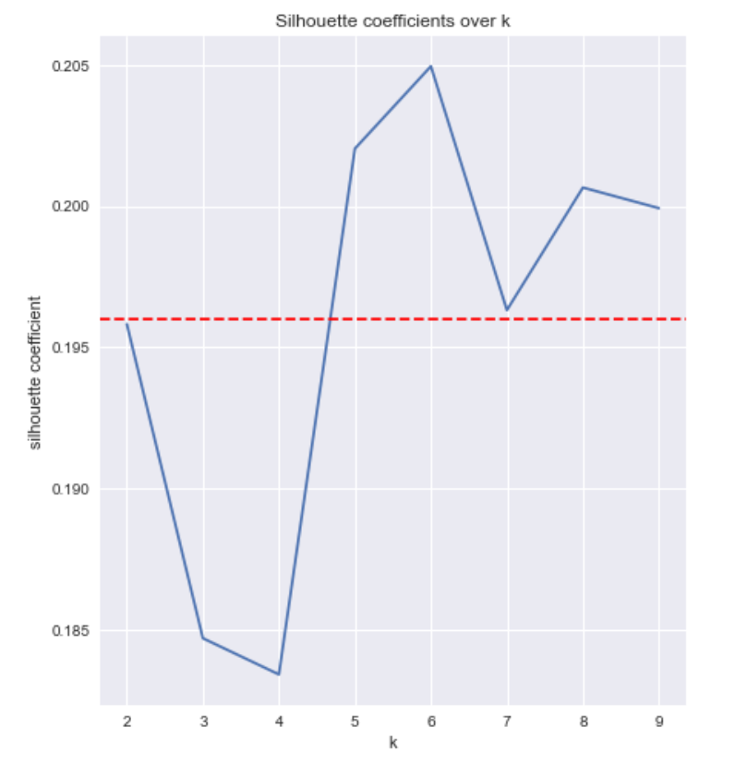

Our Approach: To uncover the underlying playing styles among players and successful teams, we relied on unsupervised clustering models for our core analysis
Hierarchical Agglomerative Clustering (HAC)
K-Means

Slide 14
Our Approach: To uncover the underlying playing styles among players and successful teams, we relied on unsupervised clustering models for our core analysis
Hierarchical Agglomerative Clustering (HAC)
K-Means
As we did not have a pre-determined number of clusters, we chose Hierarchical Agglomerative Clustering as our main model in this case.

Slide 15
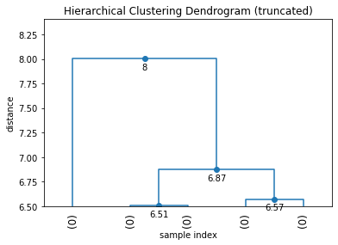
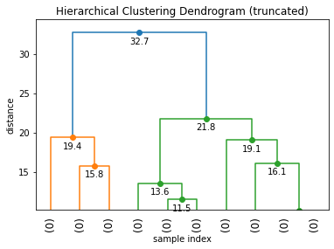
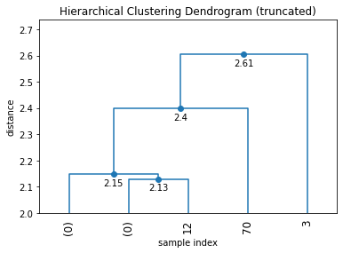
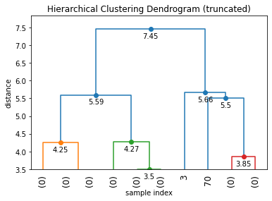
Hierarchical Agglomerative Clustering (HAC): We evaluated which of the 4 linkage methods to use for our clustering based on the given factors
Complete
Ward
Single
Average
Evaluation Factors
Dendrogram Plot
# of Clusters
Distribution of Data
(Value Counts within Clusters)

Slide 16
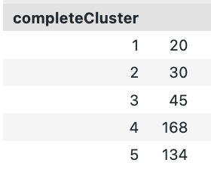
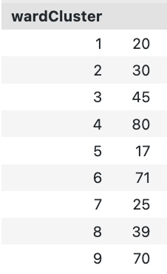
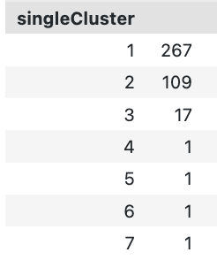
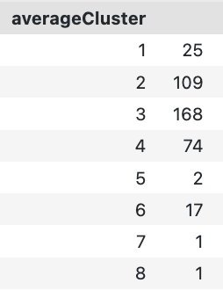
Hierarchical Agglomerative Clustering (HAC): We evaluated which of the 4 linkage methods to use for our clustering based on the given factors
Complete
Ward
Single
Average
Clusters: 5
Clusters: 9
Clusters: 7
Clusters: 8
Evaluation Factors
Dendrogram Plot
# of Clusters
Distribution of Data
(Value Counts within Clusters)
Notes:
## Chosen Linkage Method: Ward Linkage
Our ideal results would include clusters that are best able to explain the variance in player behaviour within their teams. Basketball teams field **9-10 players** every game, hence our desired number of clusters should be close to this number. Based on this, we eliminate *Complete Linkage* as a method. Next, by observation we notice that *Average* and *Single Linkage* methods produce a desirable number of clusters, but they are not well distributed (Several Clusters with only 1-2 data points). Hence, the best method to deploy would be **Wards Linkage**, which returns 9 Clusters that are fairly well distributed, and should account for the maximum variance in the data.

Slide 17
Hierarchical Agglomerative Clustering (HAC): We evaluated which of the 4 linkage methods to use for our clustering based on the given factors
Complete
Ward
Single
Average
Clusters: 5
Clusters: 9
Clusters: 7
Clusters: 8
Evaluation Factors
Dendrogram Plot
# of Clusters
Distribution of Data
(Value Counts within Clusters)
Notes:
## Chosen Linkage Method: Ward Linkage
Our ideal results would include clusters that are best able to explain the variance in player behaviour within their teams. Basketball teams field **9-10 players** every game, hence our desired number of clusters should be close to this number. Based on this, we eliminate *Complete Linkage* as a method. Next, by observation we notice that *Average* and *Single Linkage* methods produce a desirable number of clusters, but they are not well distributed (Several Clusters with only 1-2 data points). Hence, the best method to deploy would be **Wards Linkage**, which returns 9 Clusters that are fairly well distributed, and should account for the maximum variance in the data.

Slide 18
Hierarchical Agglomerative Clustering (HAC): We evaluated which of the 4 linkage methods to use for our clustering
Complete
Ward
Single
Average
Clusters: 5
Clusters: 9
Clusters: 7
Clusters: 8
We found that the best method to deploy was Wards Linkage, which returns 9 Clusters that are fairly well distributed, and should account for the maximum variance in the data.
Evaluation Factors
Dendrogram Plot
# of Clusters
Distribution of Data
(Value Counts within Clusters)
Notes:
## Chosen Linkage Method: Ward Linkage
Our ideal results would include clusters that are best able to explain the variance in player behaviour within their teams. Basketball teams field **9-10 players** every game, hence our desired number of clusters should be close to this number. Based on this, we eliminate *Complete Linkage* as a method. Next, by observation we notice that *Average* and *Single Linkage* methods produce a desirable number of clusters, but they are not well distributed (Several Clusters with only 1-2 data points). Hence, the best method to deploy would be **Wards Linkage**, which returns 9 Clusters that are fairly well distributed, and should account for the maximum variance in the data.

Slide 19


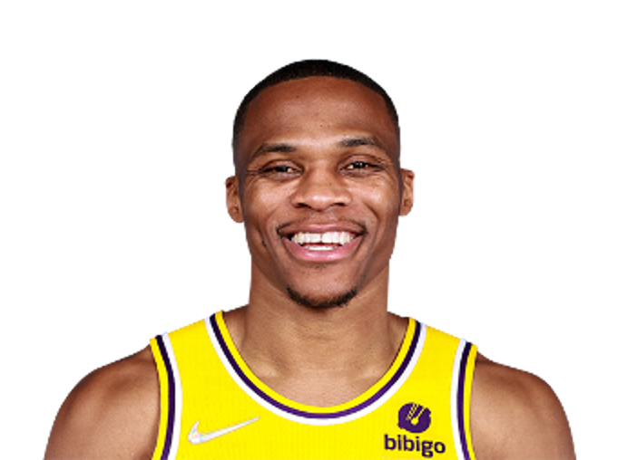




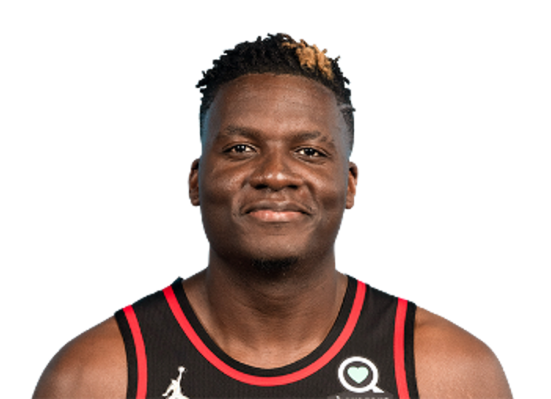

Hierarchical Agglomerative Clustering (HAC): Using Ward’s Linkage method, we were able to form 9 Clusters, and interpreted them as such
Interpreting the 9 Clusters
Cluster 1:
Elite Scoring Players
Cluster 2:
Assist Maker Guards that operate around the paint
Cluster 3:
Offensive Minded Guards
Cluster 4:
Offensive Minded Forwards
Cluster 5: Shooting Big Man
Cluster 6:
Effective Shooters
Cluster 7:
Scoring Shooters
Cluster 8:
Traditional Big Men
Cluster 9:
Rotational Players

Slide 20
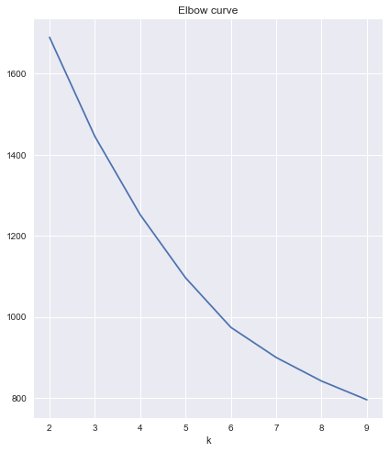
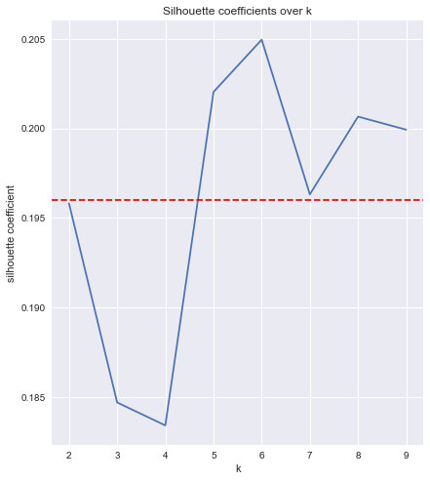
K-Means Clustering: Using the elbow plot and Silhouette coefficient, we determined the optimal number of clusters
Elbow Plot
Silhouette Coefficient
The optimal number of clusters for our K-Means Clustering was:
6

Slide 21

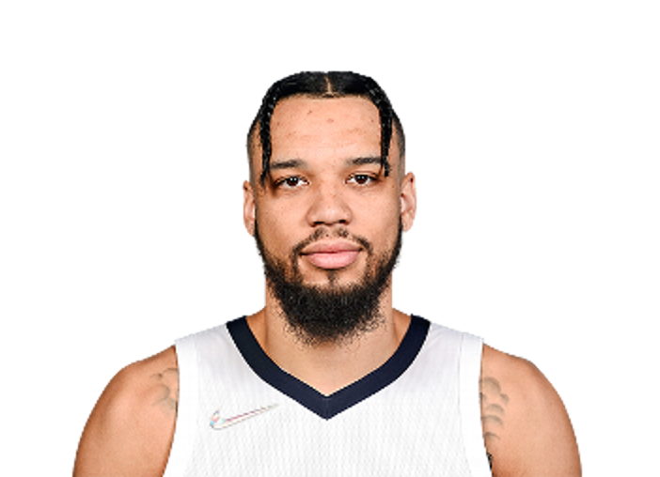

K-Means Clustering: While not ideal, we were able to form 6 Clusters, and interpreted them as such
Interpreting the 6 Clusters
Cluster 1:
Elite Offensive Forwards
Cluster 2:
Elite Solo Scorer
Cluster 3:
Paint Players
Cluster 4:
Rotational Level Players that are assisted for their shots
Cluster 5:
Decent Level Players that are not good passes
Cluster 6:
Effective Shooters

Slide 22
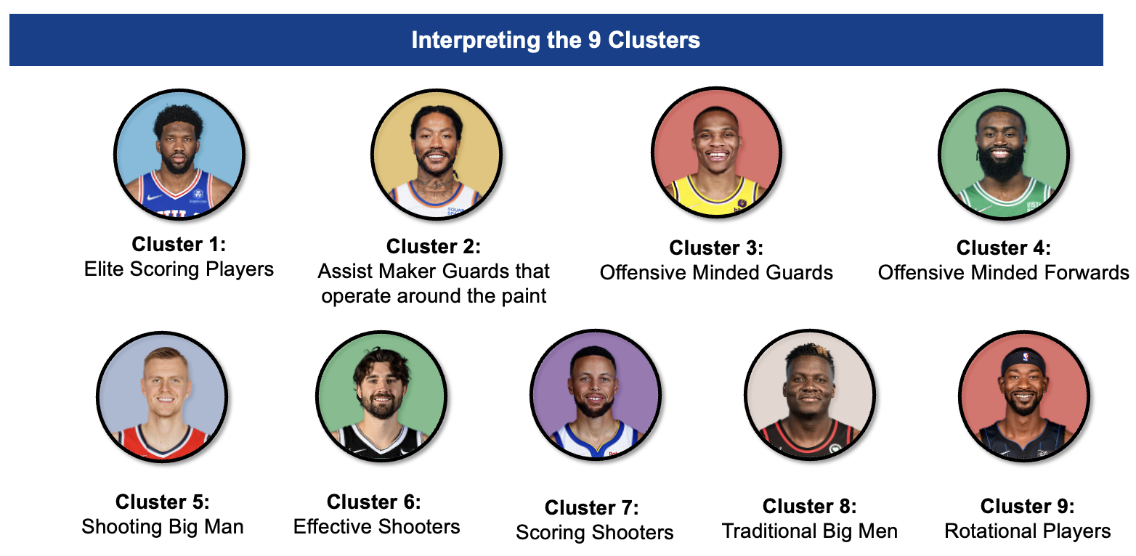
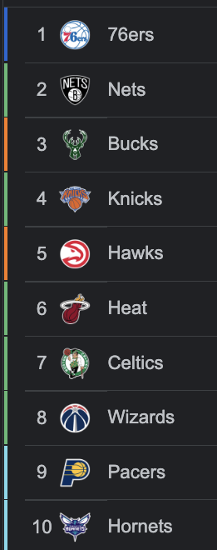
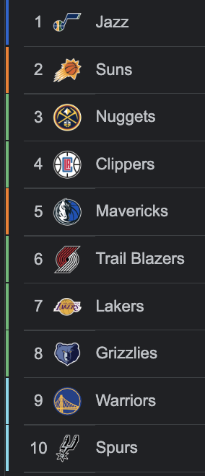
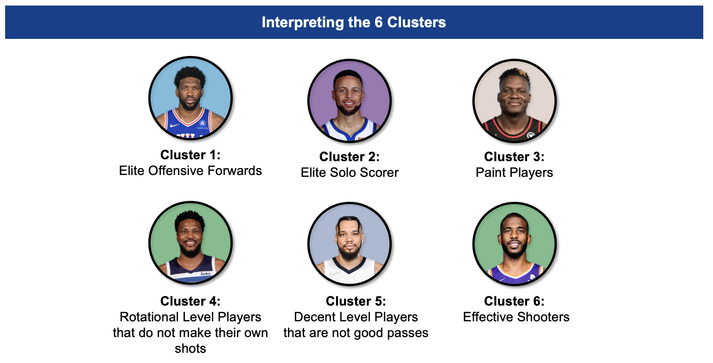
Putting it together: We are now able to study the composition of NBA teams by the Clusters generated by both Clustering Models
HAC
K-Means

Slide 23
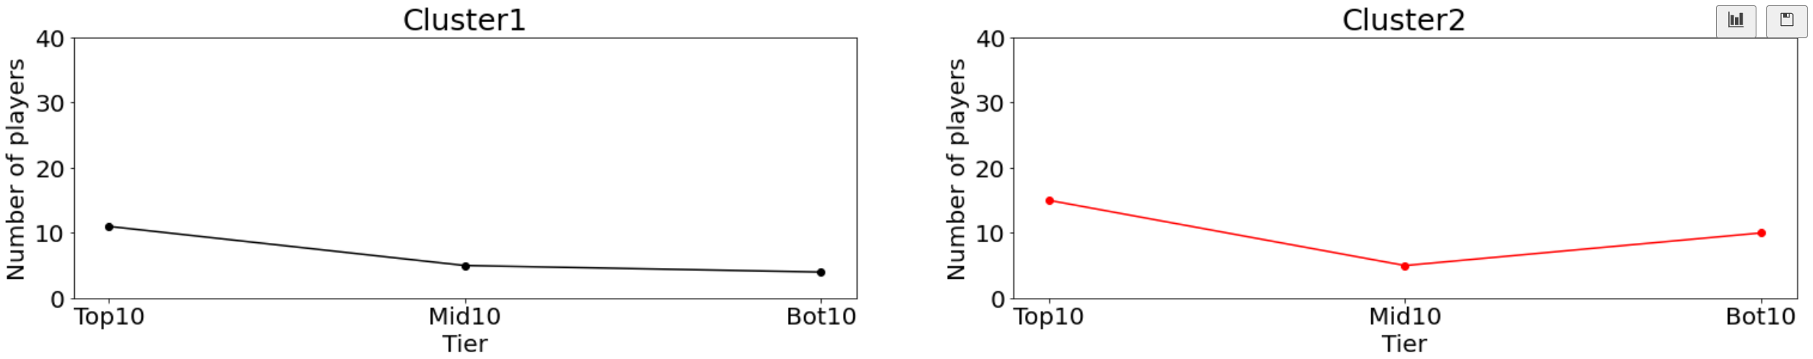
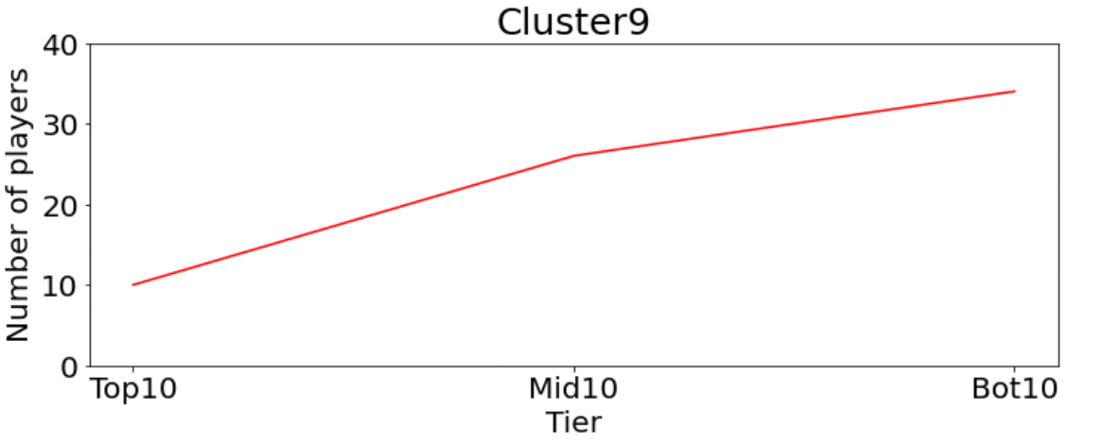
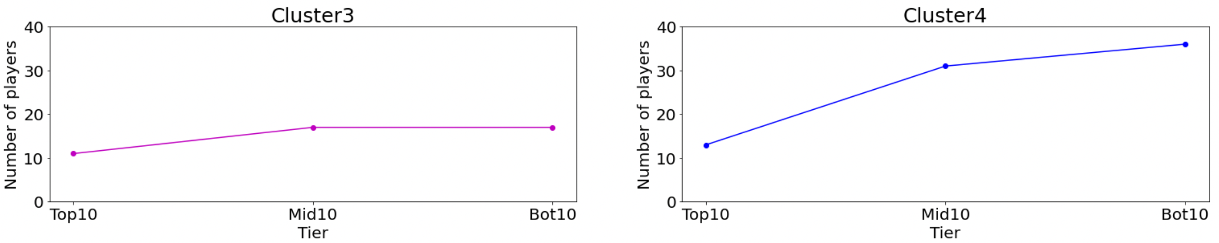
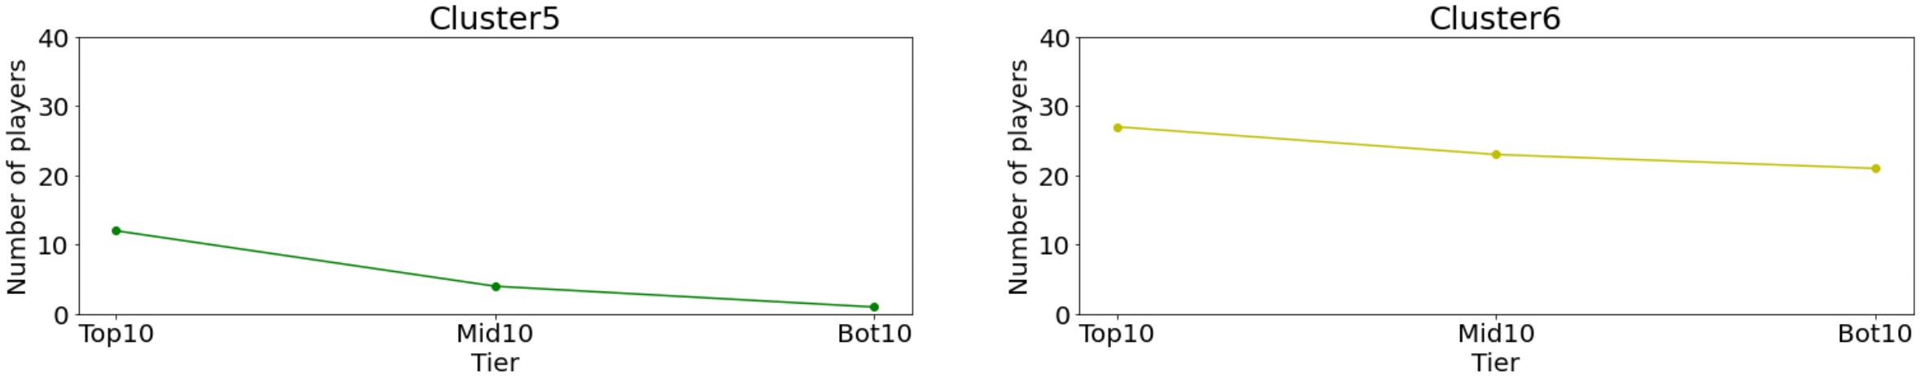
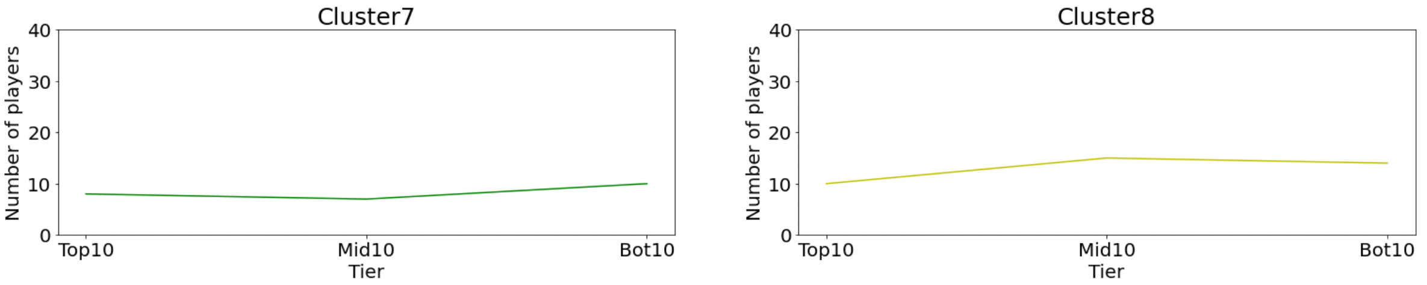
Hierarchical Agglomerative Clustering: Analysing Team Composition by Clusters

Slide 24
Hierarchical Agglomerative Clustering: Analysing Team Composition by Clusters

Slide 25
Hierarchical Agglomerative Clustering: Analysing Team Composition by Clusters
Analysis
We focus on Cluster 1, 4 & 9
The downward trend in Cluster 1 suggests that Top 10 teams comprise of a significantly higher number of players of that Cluster compared to the Middle and Bottom 10
The upward trend in Cluster 4 & 9 suggests that the Top 10 teams comprise of a significantly lower number of players of that Cluster compared to the Middle and Bottom 10

Slide 26
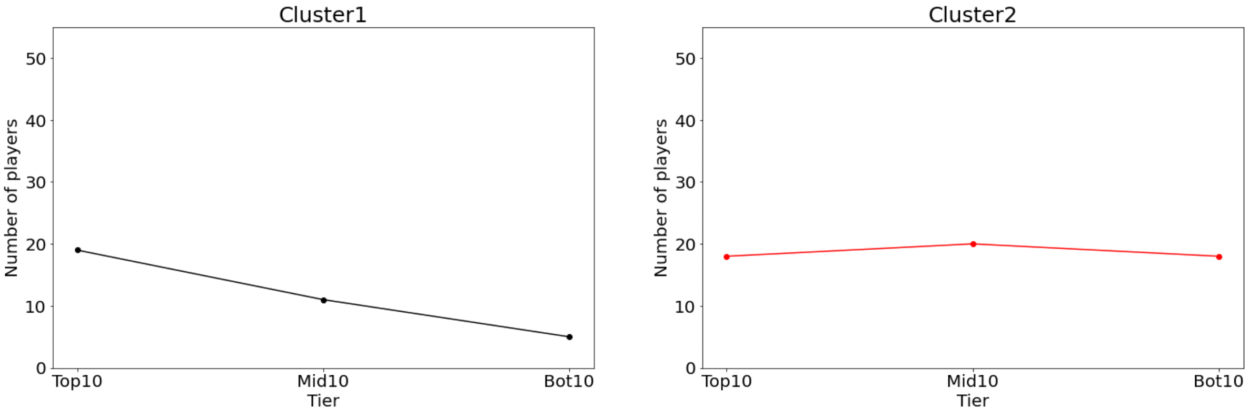
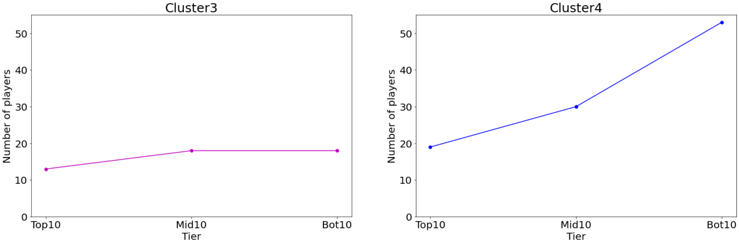
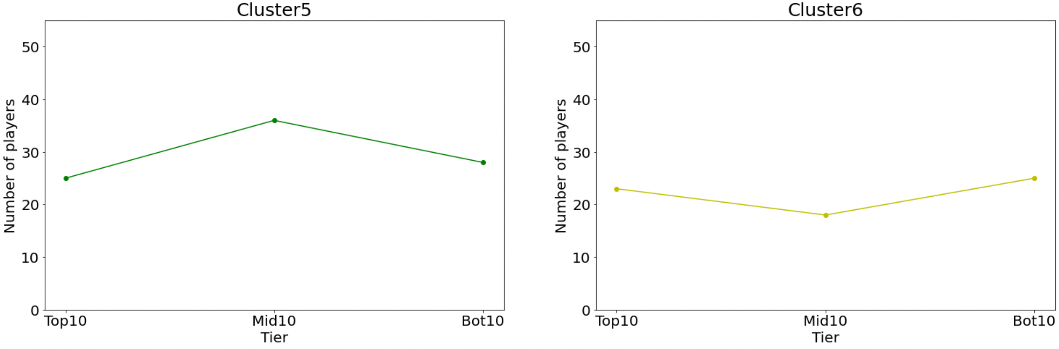
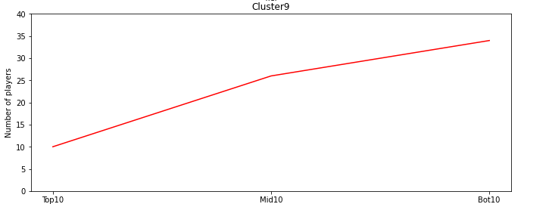
K-Means Clustering: Analysing Team Composition by Clusters
Analysis
We focus on Cluster 1 & 4
The downward trend in Cluster 1 suggests that Top 10 teams comprise of a significantly higher number of players of that Cluster compared to the Middle and Bottom 10
The upward trend in Cluster 4 suggests that the Top 10 teams comprise of a significantly lower number of players of that Cluster compared to the Middle and Bottom 10

Slide 27
How might we provide more insightful recommendations on team composition to today's managers to deal with this complexity?
Key Recommendations Derived
Hierarchical Agglomerative
K-Means
Have guards that pass well and can penetrate the paint. Allowing more varied plays
Have players that shoot well, regardless of their position
Minimize rotational-level players and fill spots with elite offensive forwards instead
Offensive supremacy means wins. Have players that synergise and dominate the game
Include Big Men

Slide 28
Evaluation & Final Thoughts:
Evaluating our Models
Challenges faced in evaluating our models
Our true evaluation metric
Do not know the true underlying clusters to compare against
Directly evaluating the results in NBA's context, the models were able to generate useful and logical recommendations
Limited practical significance derived from statistical metrics such as Silhouette Coefficient

Slide 29
Evaluation & Final Thoughts:
General Observations
Data from NBA.com seems to contain significantly more offensive playstyle statistics that may have limited the model's ability to identify strong defensive clusters
Top teams had a composition that was in fact distinct from other teams
K-Means gave less insight on the differences between top and bottom teams.
Areas for future exploration
Gather more defense data
Could use play styles generated to redefine team roles and tactics

Slide 30
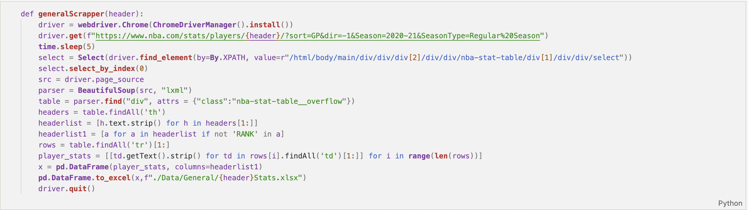
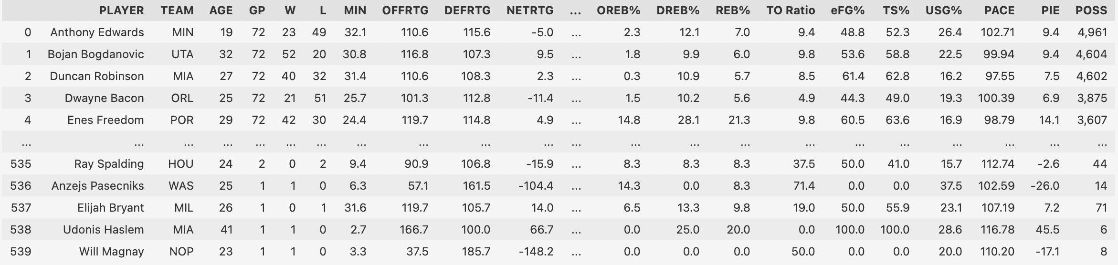
The Problem:

Slide 31
Hierarchical Agglomerative Clustering:
## Chosen Linkage Method: Ward Linkage
Our ideal results would include clusters that are best able to explain the variance in player behaviour within their teams. Basketball teams field **9-10 players** every game, hence our desired number of clusters should be close to this number. Based on this, we eliminate *Complete Linkage* as a method. Next, by observation we notice that *Average* and *Single Linkage* methods produce a desirable number of clusters, but they are not well distributed (Several Clusters with only 1-2 data points). Hence, the best method to deploy would be **Wards Linkage**, which returns 9 Clusters that are fairly well distributed, and should account for the maximum variance in the data.

Slide 32
### Cluster 6 - Effective Shooters
From hCLUSTERS, we can see that PC2 and PC3 is negative.
Coupled together with the stats, we can tell that the players in this clusters are effective shooters of the ball. They are good at pull ups and catch and shoot.
Hierarchical Agglomerative Clustering:
### Cluster 5 - Shooting Big Man
From hCLUSTER5, we can that the PC2 is positive and PC3 and PC5 is negative
Coupled together with the stats, we can tell that the players in this clusters are big men that can shoot the ball well
### Cluster 1 - Elite Scoring Players
From hCLUSTER 1, we can see that the players generally have high PC2 and a low PC3 value.
This means that these players are offensive minded stars that are not focusing on assist and can shoot the ball well
### Cluster 2 - Assist Maker Guards that operate around the paint
From hCLUSTER 2, we can see that the players generally have a negative low PC1, PC2, PC4 value while they have a postive low PC3 and PC5 value.
This implies that these player are not centers but are guards that operate around the paint that pass and score mainly around there.
### Cluster 3 - Offensive Minded Guards
From hCLUSTER3, we can see that the players have negative PC1 values and positive PC2 Values.
This implies that the players are guards that are offensive minded.
### Cluster 4 - Offensive Minded Forwards
From hCLUSTER4, we can see that the PC2 values are postive and PC3 values are negative
This implies that the players are scoring focused forwards that do not operate mainly around the paint.
### Cluster 7 - Scoring Shooters
From hCLUSTERS, we can see that PC1 and PC4 is negative while PC2 is positive.
Coupled together with the stats, we can tell that the players In this clusters focus on scoring and do not mainly score from the paint.
### Cluster 9: Rotational Players
Players in this cluster are not elite in any specific category. THey are average players with a negative PC4, indicating that their net rating is not positive.
### Cluster 8 - Traditional Big Men
From hCLUSTERS, we can see that PC1 and PC2 is positive while the rest of the PCs are mixed.
Coupled together with the stats, we can tell this players are primarily based around in the paint area during the game. They really make most of their points there.

Slide 33
K-Means Clustering:
### Cluster 1 - Elite Offensive Forwards
From kCLUSTERS, we can see that PC2 is especially high for these groups of players
Coupled together with the stats, we can tell this players are elite scorers and are forwards
### Cluster 2 - Elite Solo Scorer
From kCLUSTERS, we can see that PC2 is high for these groups of players but the PC4 is negative
Coupled together with the stats, we can tell this players are elite scorers as well but they made their buckets by themselves (unassisted)
### Cluster 4 - Rotational Level Players that do not make their own shots
From kCLUSTERS, we can see that PC3 and PC4 are negative for these groups of players
Coupled together with the stats, we can tell this players are average players that operate out of the paint and not make their own shots
### Cluster 3 - Paint Players
From kCLUSTERS, we can see that PC1 and PC2 is high for these groups of players
Coupled together with the stats, we can tell this players are based around the Paint
### Cluster 5 - Decent Level Players that are not good passes
From kCLUSTERS, we can see that PC3 and PC5 are negative for these groups of players
Coupled together with the stats, we can tell this players are decent players that operate out of the paint and make poor passes
### Cluster 6 - Guards that focus on driving
From kCLUSTERS, we can see that PC1 and PC5 are negative for these groups of players
Coupled together with the stats, we can tell this players are guards that operate out of the paint and focus on driving the ball

